Slide 1
Greedy Monochromatic Island Partitions
Steven van den Broek Wouter Meulemans Bettina Speckmann TU Eindhoven

Slide 2
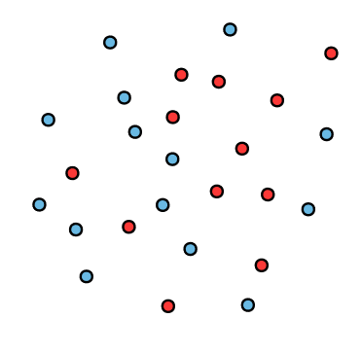
Colored points
Notes:
Discrete and computational geometrists alike love colored points.

Slide 3
Colored points

Slide 4
Colored points
Ham sandwich theorem
Notes:
Example: ham sandwich theorem. Equally many of each color in both half-planes

Slide 5
Colored points
6
7
6
7
Ham sandwich theorem
Notes:
Colored points. There are many discrete and computational geometry questions you can ask (and answer) about such colored points.

Slide 6
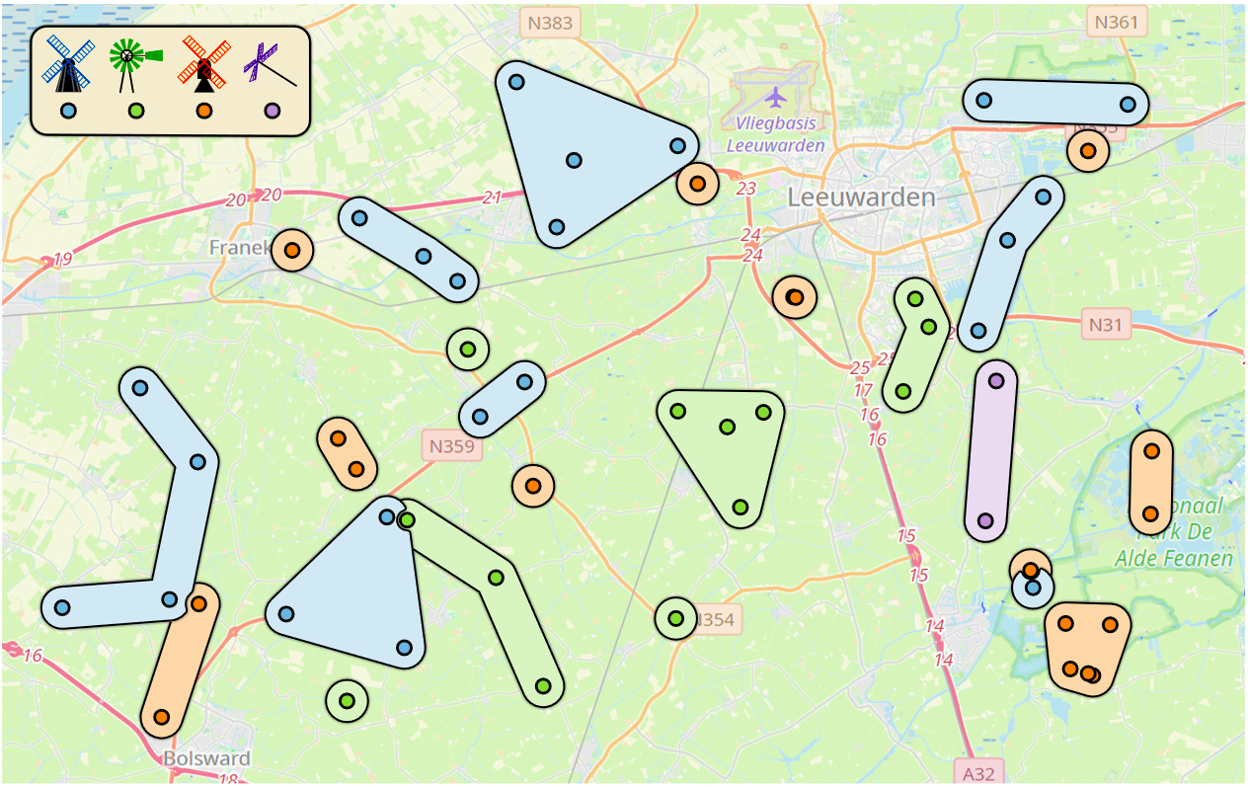
Spatial set visualization
Notes:
Our motivation to study colored points: spatial set visualization.

Slide 7
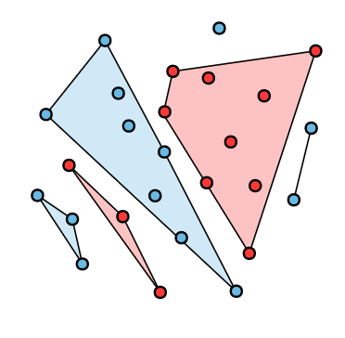
Monochromatic island partitions
Notes:
This led us to studying the problem of partitioning colored points with convex shapes into sets called islands.

Slide 8
Monochromatic island partitions
Definition. [Bautista-Santiago et al. (2011)] A subset $I$ of the input points $S$ is an island if $CH\left(I\right)∩S=I$.
We consider only monochromatic islands.

Slide 9
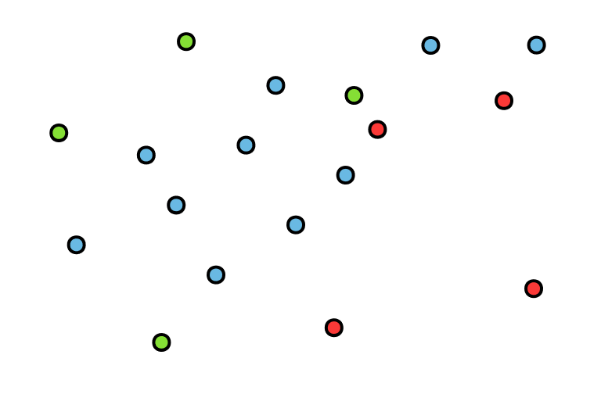
Monochromatic island partitions
Definition. [Bautista-Santiago et al. (2011)] A subset $I$ of the input points $S$ is an island if $CH\left(I\right)∩S=I$.
We consider only monochromatic islands.
Notes:
Consider only monochromatic islands.

Slide 10
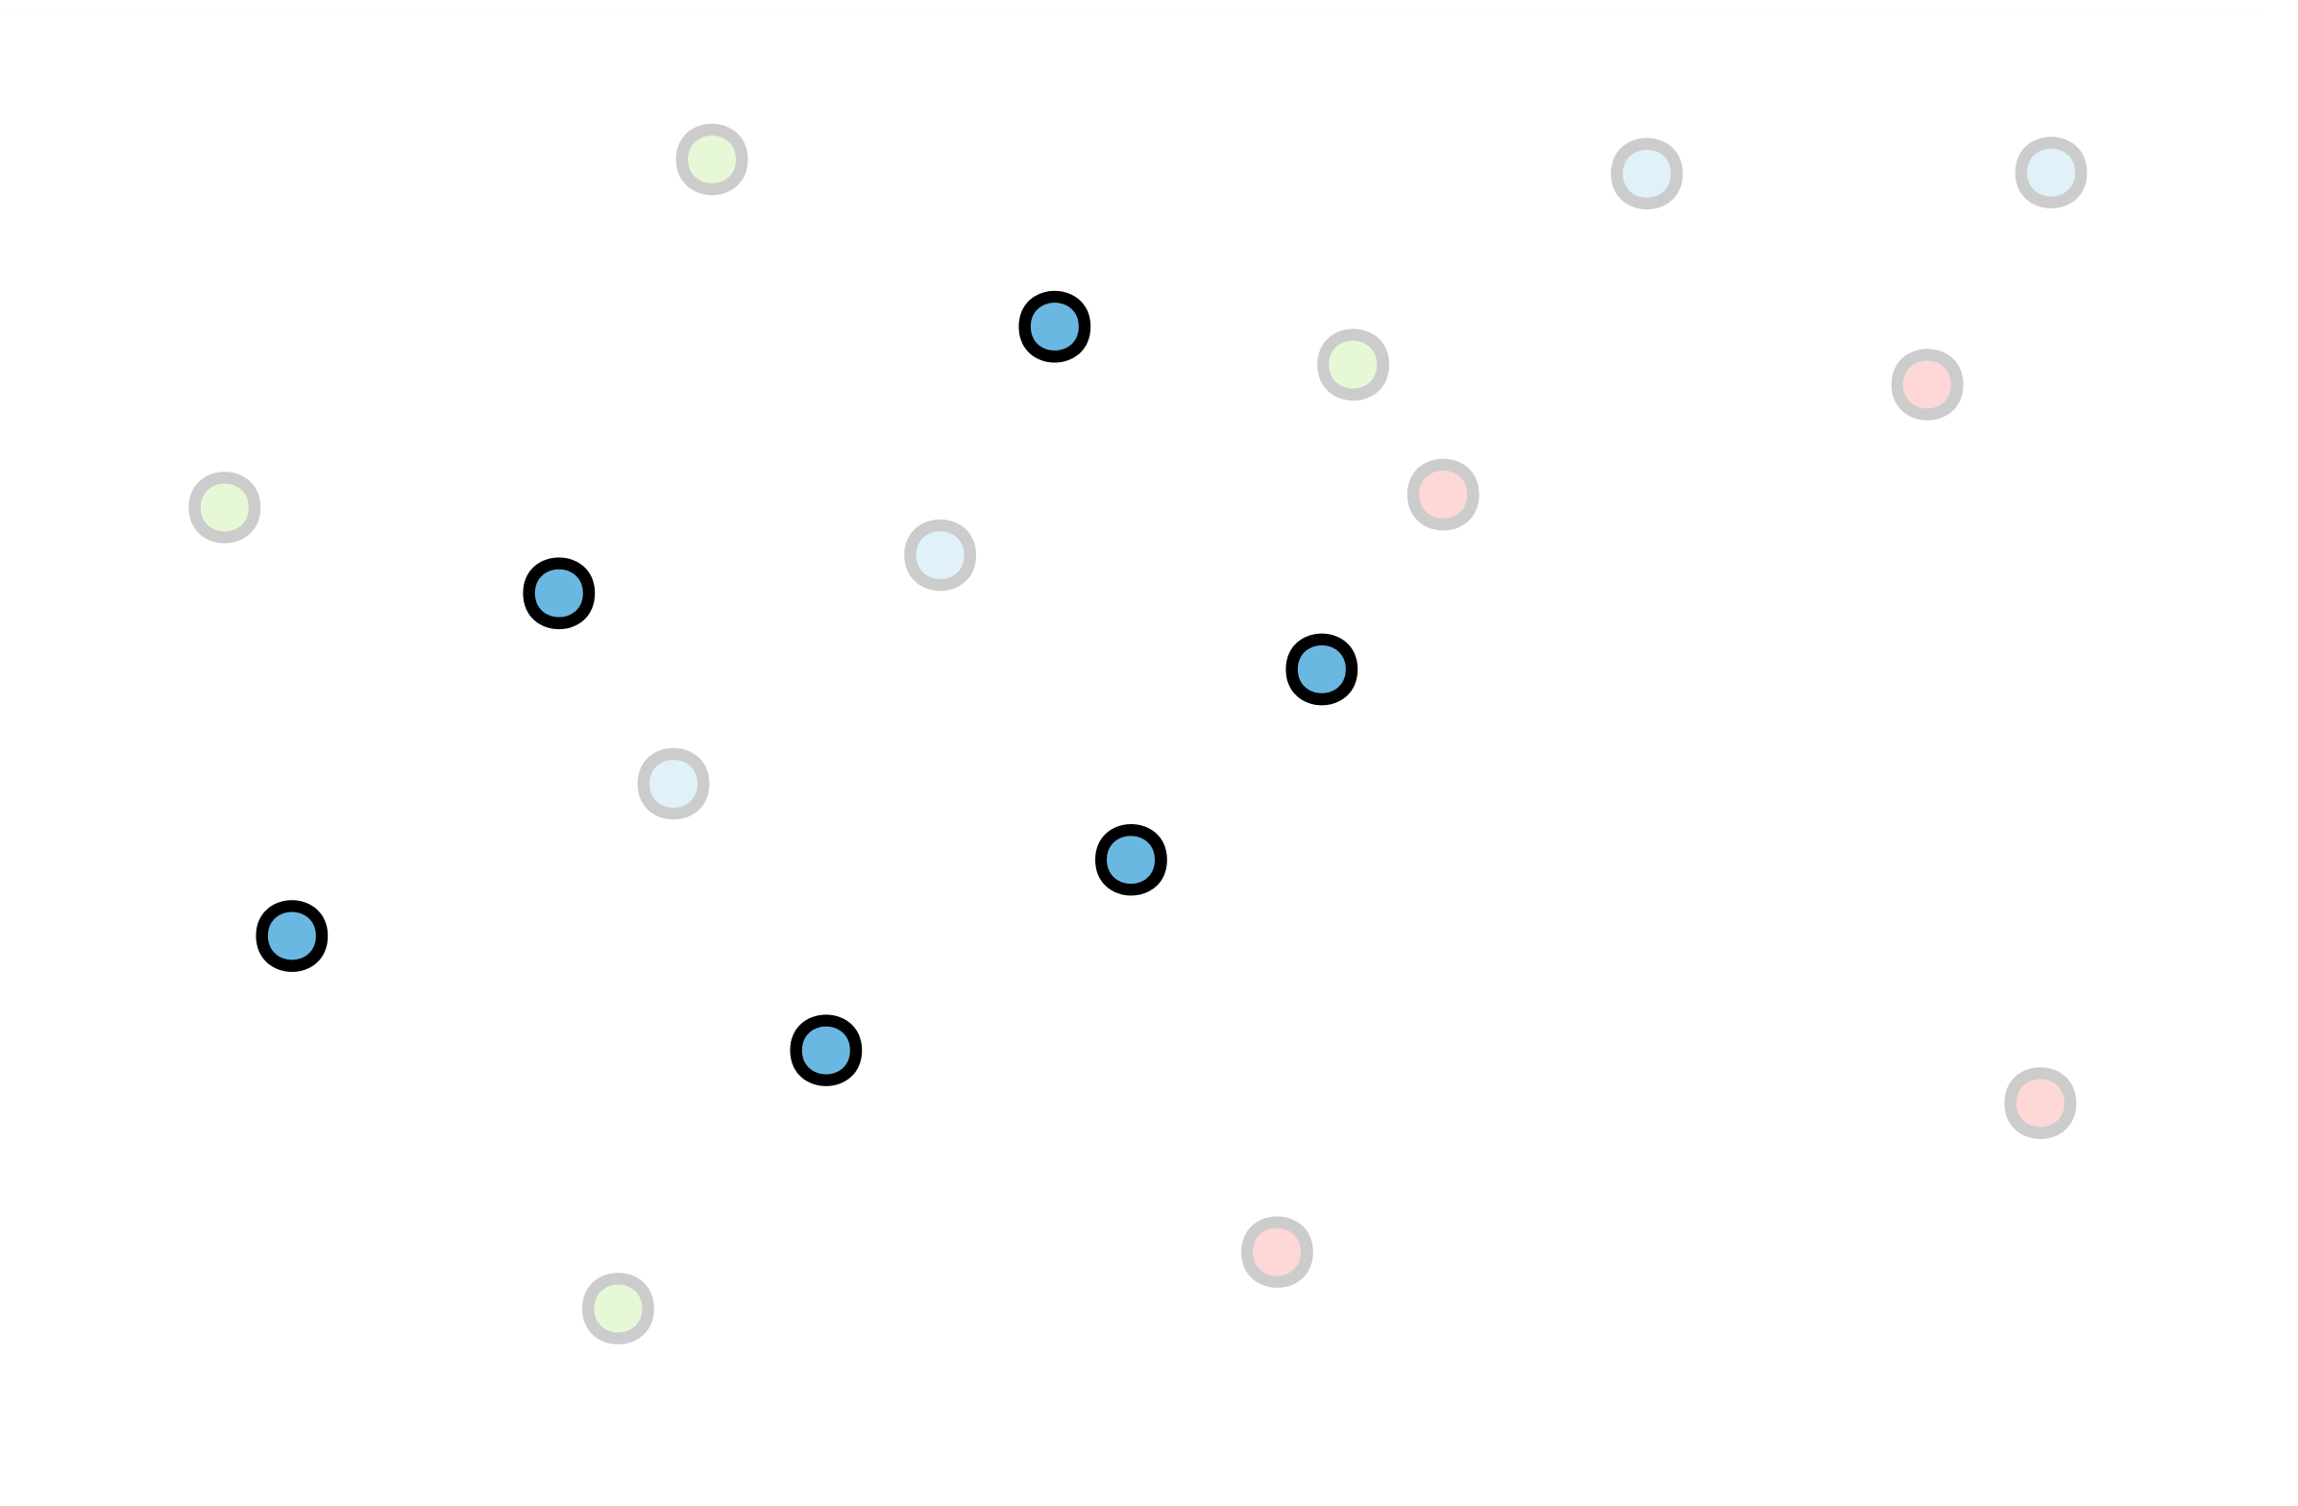
Monochromatic island partitions
Definition. [Bautista-Santiago et al. (2011)] A subset $I$ of the input points $S$ is an island if $CH\left(I\right)∩S=I$.
We consider only monochromatic islands.

Slide 11
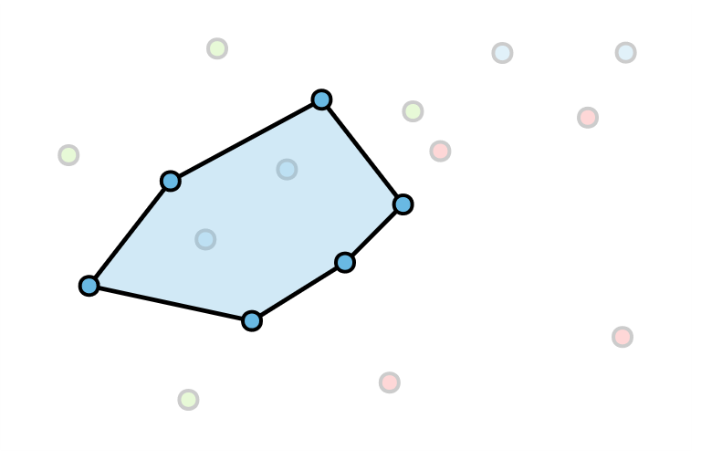
Monochromatic island partitions
Definition. [Bautista-Santiago et al. (2011)] A subset $I$ of the input points $S$ is an island if $CH\left(I\right)∩S=I$.
We consider only monochromatic islands.

Slide 12
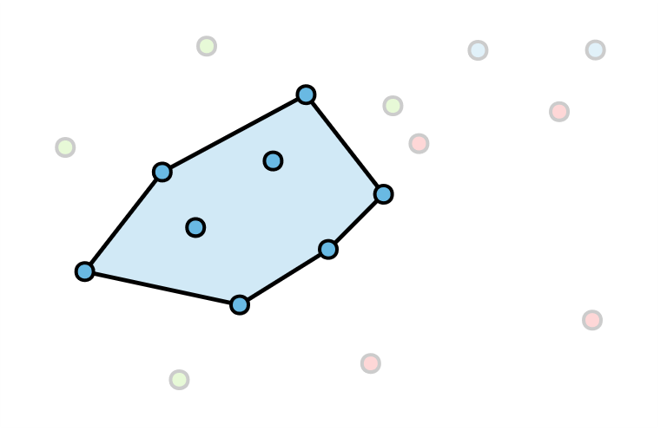
Monochromatic island partitions
Definition. [Bautista-Santiago et al. (2011)] A subset $I$ of the input points $S$ is an island if $CH\left(I\right)∩S=I$.
We consider only monochromatic islands.

Slide 13
Monochromatic island partitions
Definition. [Bautista-Santiago et al. (2011)] A subset $I$ of the input points $S$ is an island if $CH\left(I\right)∩S=I$.
The convex hulls of islands in a partition are pairwise-disjoint.
Theorem. [Dumitrescu and Pach (2002)] For $r$ red points and $b$ blue points, $≈min⁡(r, b)$ islands are sufficient and sometimes necessary to partition the points.
Theorem. [Bautista-Santiago et al. (2011)] The largest island can be found in $O\left(n^{3}\right)$ time.

Slide 14
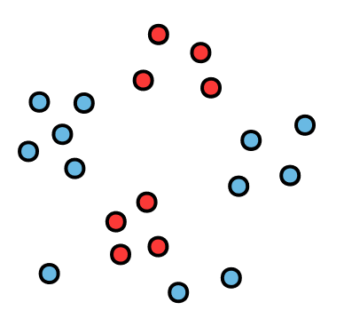
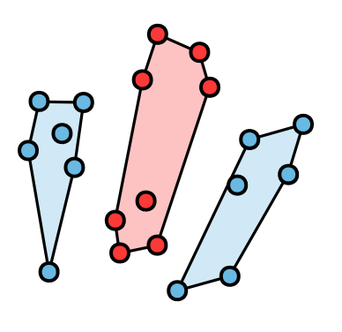
Monochromatic island partitions
Problem. Compute a minimum-cardinality island partition.

Slide 15
Monochromatic island partitions
?
Minimum-cardinality
island partition

Slide 16
Related monochromatic partitions

Slide 17
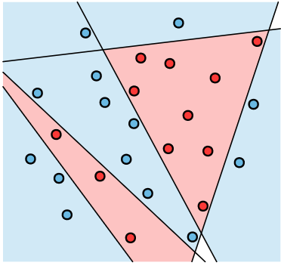
Related monochromatic partitions
Finding the minimum number of lines is NP-hard, APX-hard, W[1]-hard [Megiddo (1988), Călinescu et al. (2005), Bonnet et al. (2019)]

Slide 18
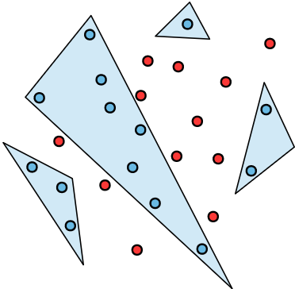
Related monochromatic partitions
Finding the minimum number of triangles is NP-hard [Agarwal and Suri (1998)]

Slide 19
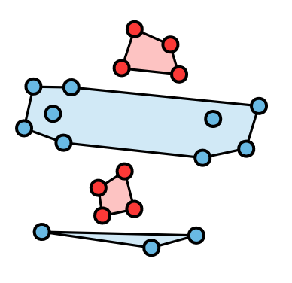
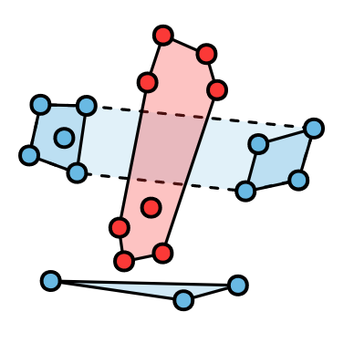
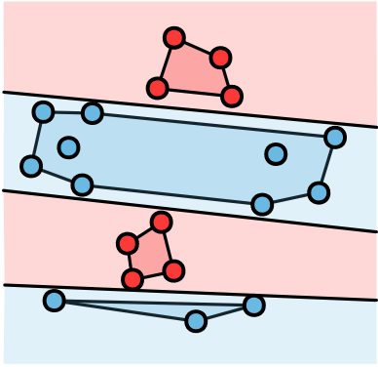
Greedy algorithms
Disjoint-greedy
Overlap-greedy
Line-greedy
Notes:
3:50

Slide 20
Greedy algorithms
Disjoint-greedy
Overlap-greedy
Line-greedy

Slide 21
Disjoint-greedy
Choose a largest island that is disjoint from previous islands

Slide 22
Disjoint-greedy: lower bound
Lemma. Disjoint-greedy has approximation ratio $Ω\left(n/\log^{2}{n}\right)$.
# input points

Slide 23
Disjoint-greedy: lower bound
Two opposing complete binary trees of height $ℓ$

Slide 24
Disjoint-greedy: lower bound
Two opposing complete binary trees of height $ℓ$

Slide 25
Disjoint-greedy: lower bound
Two opposing complete binary trees of height $ℓ$
$2^{i+6}$ red points at height $i∈\{0, ℓ−1\}$

Slide 26
Disjoint-greedy: lower bound

Slide 27
Disjoint-greedy: lower bound

Slide 28
Disjoint-greedy: lower bound
Among the horizontal and vertical red islands, the middle vertical island has largest cardinality

Slide 29
Disjoint-greedy: lower bound

Slide 30
Disjoint-greedy: lower bound

Slide 31
Disjoint-greedy: lower bound

Slide 32
Disjoint-greedy: lower bound

Slide 33
Disjoint-greedy: lower bound
$Ω(2^{ℓ})$ islands

Slide 34
Disjoint-greedy: lower bound
$Ω(2^{ℓ})$ islands
$O(ℓ)$ islands

Slide 35
Disjoint-greedy: lower bound
Two opposing complete binary trees of height $ℓ$
$2^{i+6}$ red points at height $i∈\{0, ℓ−1\}$

Slide 36
Disjoint-greedy: lower bound
Lemma. Disjoint-greedy has approximation ratio $Ω\left(n/\log^{2}{n}\right)$.

Slide 37
Greedy algorithms
Disjoint-greedy
Overlap-greedy
Line-greedy
Notes:
8:00

Slide 38
Greedy algorithms
Disjoint-greedy
Overlap-greedy
Line-greedy

Slide 39
Overlap-greedy
Choose an island that covers most uncovered points
Not a partition, but a cover!

Slide 40
Overlap-greedy
Choose an island that covers most uncovered points
Cover
Partition
$O(\log{n})$-approximation
(set cover)

Slide 41
Overlap-greedy: lower bound
$$k$$
$$k+1$$

Slide 42
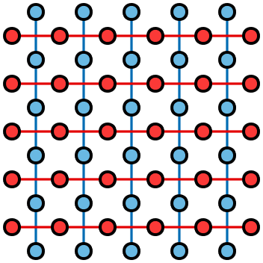
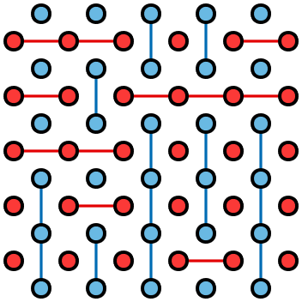
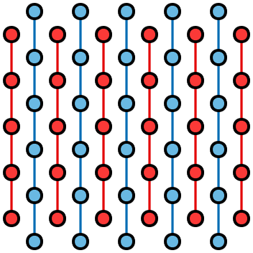
Overlap-greedy: lower bound
$Ω\left(k^{2}\right)$ islands
$O\left(k\right)$ islands
Overlap-greedy island cover
Compatible island partition
Optimal partition

Slide 43
Overlap-greedy: lower bound
Lemma. Any algorithm compatible with overlap-greedy has approximation ratio $Ω\left(\sqrt{n}\right)$.

Slide 44
Overlap-greedy: lower bound
Lemma. Any algorithm compatible with overlap-greedy has approximation ratio $Ω\left(\sqrt{n}\right)$.
Lemma. There exists an algorithm compatible with overlap-greedy that has approximation ratio $O\left(\text{Op}t_{P}^{2}\log^{2}{n}\right)$.
Cardinality of an optimal island partition

Slide 45
Greedy algorithms
Disjoint-greedy
Overlap-greedy
Line-greedy
Notes:
9:50

Slide 46
Greedy algorithms
Disjoint-greedy
Overlap-greedy
Line-greedy

Slide 47
Line-greedy
Choose a line that separates most bichromatic pairs

Slide 48
Line-greedy
Choose a line that separates most bichromatic pairs
Separating lines
Island partition
$O(\log{n})$-approximation
(set cover)

Slide 49
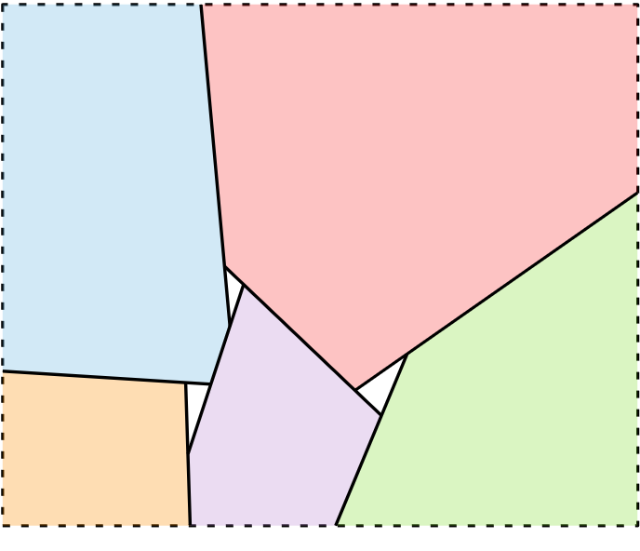
Line-greedy
$k$ lines induce $O\left(k^{2}\right)$ convex regions
$k$ islands induce $O\left(k\right)$ separating lines
[Edelsbrunner, Robison, and Shen (1990)]

Slide 50
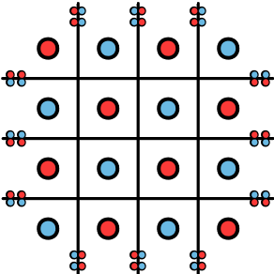
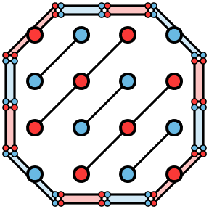
Line-greedy
Lemma. Line-greedy induces an $O\left(\text{Op}{\text{t}}_{P}^{}\log^{2}{n}\right)$-approximation to the minimum-cardinality island partition.
Idea for $Ω\left(\sqrt{n}\right)$ lower bound:
Line-greedy
induces $Ω(n)$ islands
Partition into $O\left(\sqrt{n}\right)$ islands

Slide 51
Greedy algorithms
Disjoint-greedy
Overlap-greedy
Line-greedy
$Ω\left(n/\log^{2}{n}\right)$
$$Ω\left(\sqrt{n}\right)$$
$Ω\left(\sqrt{n}\right)$ ?
$$O\left(n\right)$$
$$O\left({\text{Opt}}_{}^{2}\log^{2}{n}\right)$$
$$O\left({\text{Opt}}_{\text{P}}^{}\log^{2}{n}\right)$$

