Slide 1
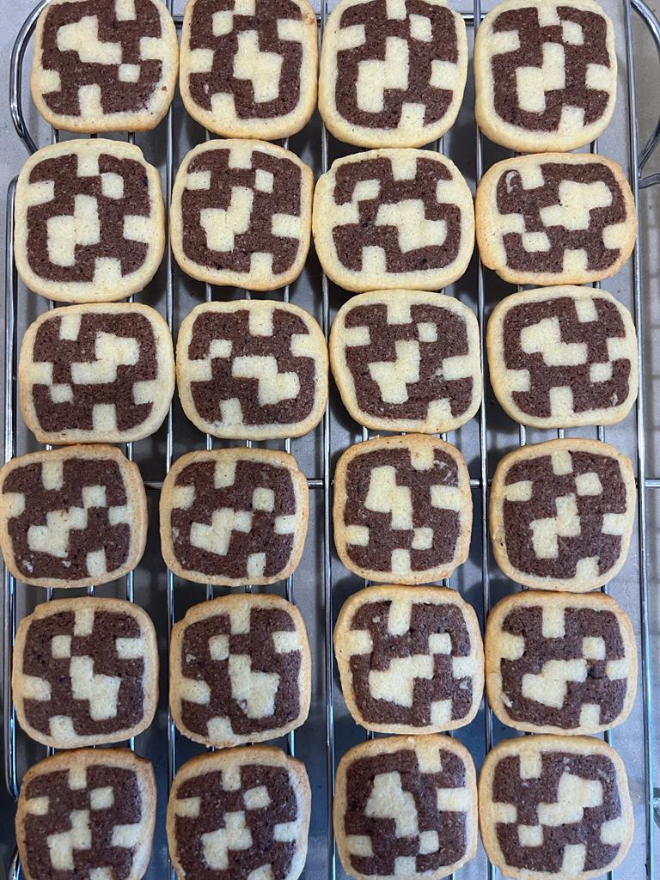
On Totally Concave Polyominoes
Minimal Area, Efficient Enumeration, and Asymptotics
Gill Barequet, Noga Keren and Adi Rivkin – Technion IIT
Johann Peters – Univ. of Waterloo

Slide 2
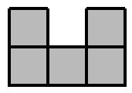
Polyomino
An edge-wise connected collection of cells on the square lattice.
Polyomino’s bounding box – smallest surrounding rectangle.

Slide 3
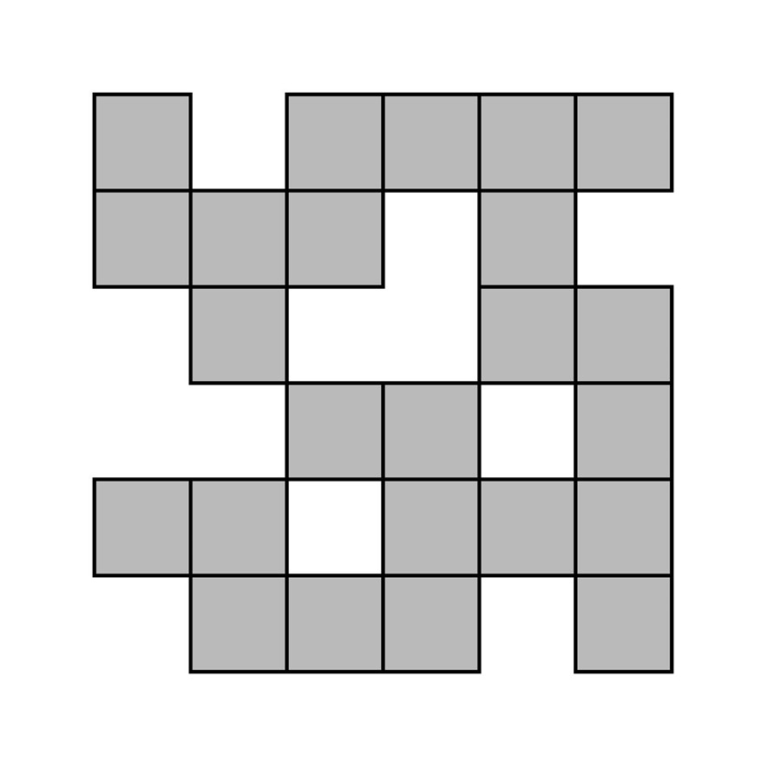
Total Concavity
Total concavity $≔$‘jump’ in every row and column.
What is the smallest TCP?
How can TCPs be efficiently counted?

Slide 4
What is the smallest TCP?

Slide 5
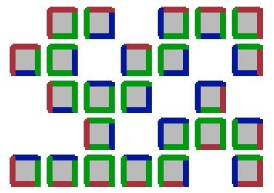
Minimal Area of TCPs
Consider a TCP of area $n$ in a $(m, l)$ bounding box.
Obtain the following relations:
(1) Lower bound:
$$n≥2m+2l−1$$
(2) Upper bound (WLOG, $l≥m)$:
$$⇒n≤ml−(l+2)$$

Slide 6
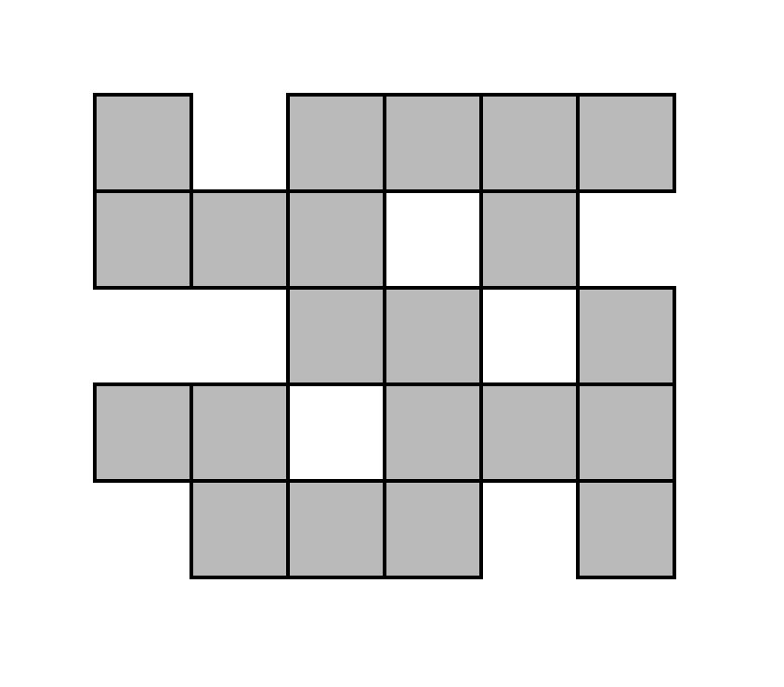
Combining UB and LB
By case analysis, the minimal values:
$\left(m, l\right)=\left(5, 6\right)⇒n≥21$
$n=21$
1
2
3
4
5
6
7
8
9
10
11
12
13
14
15
16
17
18
19
20
21

Slide 7
How can TCPs be efficiently counted?

Slide 8
Prototype Backtracking Algorithm
Notation: $κ\left(n\right)=\#TCP(n)$
Recursively concatenate concave columns
$κ(n)$ up to $n=26$
Python
12GB RAM
90 hours
Notes:
branches where the area of the polyomino became too large, or a component of the polyomino became permanently detached

Slide 9
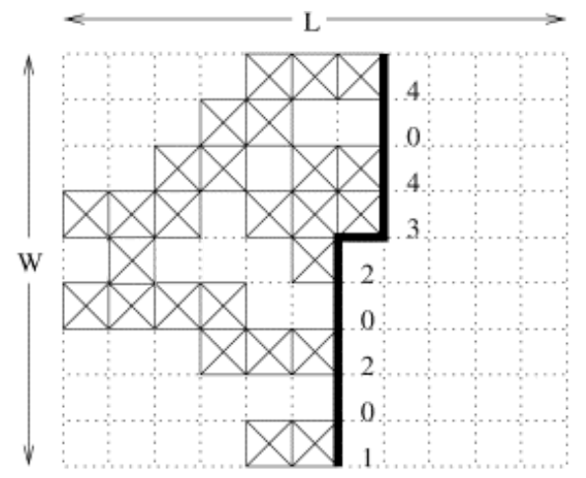
Jensen’s Algorithm (Jensen, 2001)
Counts polyominoes without generating all possible polyominoes
Tracks only right boundaries of the polyominoes
Left to right, top to bottom
Notes:
Jensen’s algorithm counts polyominoes within horizontal bounding strips of height h, where 1 ≤ h ≤ ⌈n/2⌉. The algorithm considers column by column from left to right, and cell by cell from top to bottom within each column. At each cell, the algorithm considers either to have it occupied (belonging to the polyomino) or empty (not belonging). At all stages, the algorithm does not keep in memory all polyominoes but all possible right boundaries of polyominoes, that is, all combinations of the last h cells considered.
Only the right boundaries are needed, since the past of the polyominoes doesn’t affect their future (besides their connectivity components).

Slide 10
Jensen’s Algorithm (Jensen, 2001)
Consisted of signatures
Occupied cells (boundary)
Connectivity components
Two bits – specify whether the polyomino touched top and bottom strips
Maintains a dictionary database of signatures : #polyominoes

Slide 11
Jensen’s Algorithm – Totally Concave Case
Consisted of signatures
Occupied cells (boundary)
Connectivity components
Two bits – specify whether the polyomino touched top and bottom strips
TC state of each row
0
1
2
3

Slide 12
Jensen’s Algorithm – Totally Concave Case
Consisted of signatures
Occupied cells (boundary)
Connectivity components
Two bits – specify whether the polyomino touched top and bottom strips
TC state of each row
0
1
2
3
Notes:
We can deduce the state of upper and lower strips based on the TC state of the upper and lower rows

Slide 13
Results – Jensen (TC Case)
$κ(n)$ up to $n=35$
C++
128GiB RAM
41 hours

Slide 14
Growth Constant of $κ(n)$
Growth constant of $A(n)$: $λ≔\lim_{n→∞}{\sqrt[n]{A\left(n\right)}}$
Growth constant of $κ(n)$: $λ_{κ}≔\lim_{n→∞}{\sqrt[n]{κ\left(n\right)}}$
Results:
Existence and finiteness of $λ_{κ}$
Lower bound

Slide 15
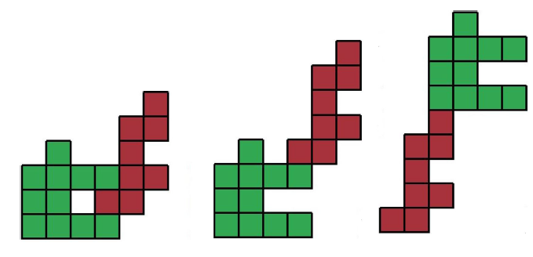
Composition and Concatenation
Composition
A relative placement.
Lexicographic order
Left to right, bottom to top.
Concatenation
A lexicographic composition.
$$c_{2}$$
$$c_{1}$$

Slide 16
$λ_{κ}$Existence and Finiteness
Concatenation of TCPs:
$$κ\left(n\right)⋅κ\left(m\right)≤κ\left(n+m\right)$$
Exponential upper bound:
$κ\left(n\right)≤λ^{n}$
By a lemma of Fekete:
$λ_{κ}≔\lim_{n→∞}{\sqrt[n]{κ\left(n\right)}}$ exists and is finite.

Slide 17
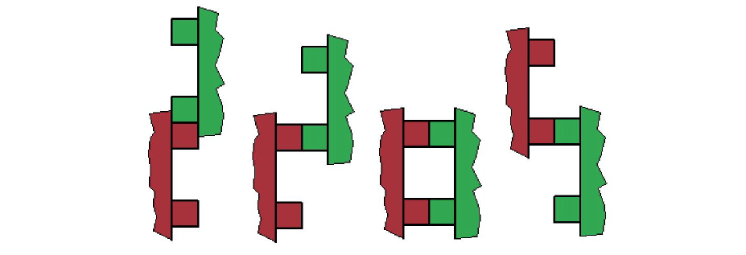
TCP Lexicographic Compositions
TCPs have at least 4 lexicographic compositions:

Slide 18
Lower Bound on $λ_{κ}$
Lexicographic compositions: $4{\left(κ\left(n\right)\right)}^{2}≤κ\left(2n\right)$
Any ${\left(4κ\left(n\right)\right)}^{\frac{1}{n}}$ is a lower bound on $λ_{κ}$.
Best lower bound ($n=35$): $λ_{κ}≥{\left(4κ\left(35\right)\right)}^{\frac{1}{35}}>2.4474$

Slide 19
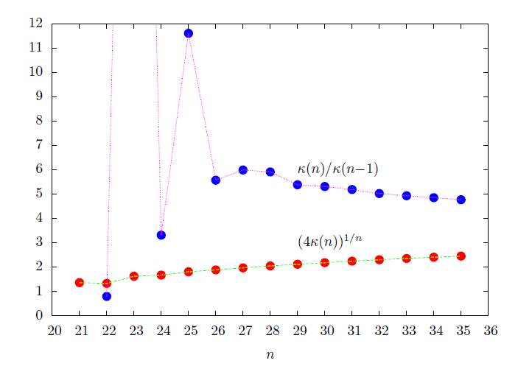

Slide 20
Efficiency Analysis – Jensen (TC Case)
$κ(n)=\tilde{Θ}\left(λ_{κ}^{n}\right)$
Lower bound: $λ_{κ}>2.4474$

Slide 21
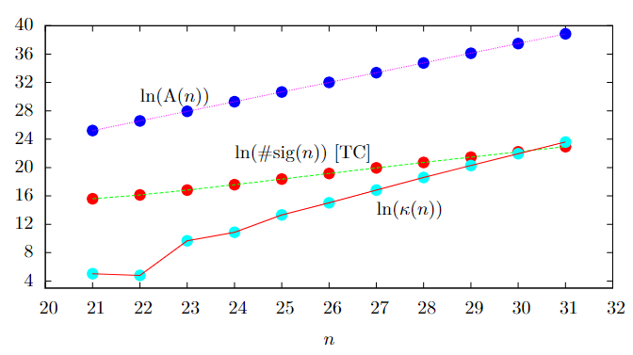
Efficiency Analysis – Jensen (TC Case)
Empirically shown: $\#sig(n)$ is $\tilde{O}({2.2}^{n})$
Algorithm is $\tilde{O}\left({2.2}^{n}\right)<\tilde{Θ}\left({2.4}^{n}\right)<\tilde{Θ}\left(λ_{κ}^{n}\right)=κ(n)$
More efficient than any algorithm which generates all TCPs!

Slide 22
Thanks for your attention!

