Slide 1



Covering Geometric Sets with Lines
Sándor Fekete, Chek-Manh Loi and Michael Perk, 14.03.24
-4/10

Slide 2
Covering Geometric Sets with Lines
Sándor Fekete, Chek-Manh Loi and Michael Perk, 14.03.24
-3/10

Slide 3
Covering Geometric Sets with Lines
Sándor Fekete, Chek-Manh Loi and Michael Perk, 14.03.24
-2/10

Slide 4
Covering Geometric Sets with Lines
Sándor Fekete, Chek-Manh Loi and Michael Perk, 14.03.24
-1/10

Slide 5
Covering Geometric Sets with Lines
Sándor Fekete, Chek-Manh Loi and Michael Perk, 14.03.24
0/10

Slide 6
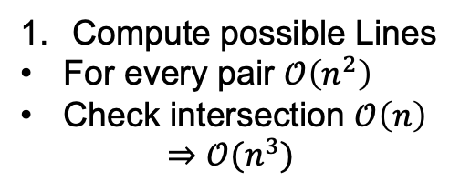
Point Line Cover
Compute possible Lines
For every pair $𝒪\left(n^{2}\right)$
Check intersection $𝒪\left(n\right)$
$$⇒𝒪(n^{3})$$
1/10

Slide 7





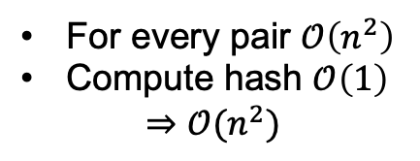








Point Line Cover
$$v_{3}$$
$$=\{v_{1},v_{2},v_{4}\}$$
( , )
$$=\{v_{1},v_{2}\}$$
( , )
$$=\{v_{3},v_{4}\}$$
$$v_{4}$$
For every pair $𝒪\left(n^{2}\right)$
Compute hash $𝒪\left(1\right)$
$$⇒𝒪(n^{2})$$
$$v_{2}$$
$$Δ_{1}$$
$$Δ_{2}$$
$$Δ_{1}$$
$$v_{1}$$
$$x_{1}$$
$$x_{2}$$
$$x_{1}$$
2/10

Slide 8
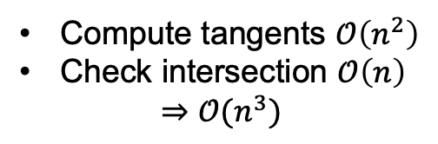
Naïve Approach
Only consider tangents
Proof that any pair is sufficient
Compute tangents $𝒪\left(n^{2}\right)$
Check intersection $𝒪\left(n\right)$
$$⇒𝒪(n^{3})$$
3/10

Slide 9
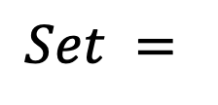

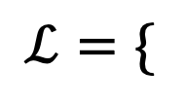
General Line Cover
$$Set =$$
$$ℒ=\{$$
}
$$,$$
$$,$$
4/10

Slide 10
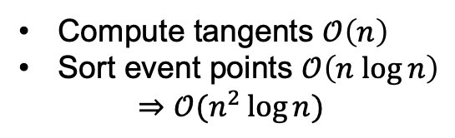
General Line Cover
Compute tangents $𝒪\left(n\right)$
Sort event points $𝒪\left(n log⁡n\right)$
$$⇒𝒪(n^{2}\log{n})$$
5/10

Slide 11
Algorithmic Approaches
6/10

Slide 12
Evaluation (PLC)
7/10

Slide 13
Evaluation (PLC)
8/10
Notes:
#instances 300
Size 100-6000
500x500 grid
4-8 grid points on lines

Slide 14
Evaluation (GLC)
9/10

Slide 15
Evaluation (GLC)
10/10
Notes:
#instances 65
Size 50-650
uniform in circle
Grid 20x20
convex polygons point cloud in 1x1 grid

Slide 16
Thank You For Your Attention!
Covering Geometric Sets with Lines
Sándor Fekete, Chek-Manh Loi and Michael Perk, 14.03.24
12/10

Slide 17
Instances (GLC)
11/10

Slide 18
Instances (PLC)
12/10

Slide 19
Absolute solution PLC
13/10
Notes:
500x500 grid
4-8 grid points on lines

Slide 20
Absolute solution GLC
14/10
Notes:
500x500 grid
4-8 grid points on lines

