Slide 1
Lower Bounding Faithful Sets of Verbose Persistence Diagrams
Brittany Fasy Montana State
David Millman Montana State, Blocky Inc.
Anna Schenfisch TU Eindhoven
Notes:
This is the ALGA slide template.
You can pick a different logo variant by changing the title slide's layout (in Home > Slides > Layout).
Alternatively, you can change the title slide completely (e.g., to add another institute's logo) by using the Slide Master view.

Slide 2
Lower-Star Filtrations

Slide 3
Lower-Star Filtrations

Slide 4
Lower-Star Filtrations

Slide 5
Lower-Star Filtrations

Slide 6
Lower-Star Filtrations

Slide 7
Lower-Star Filtrations

Slide 8
Lower-Star Filtrations

Slide 9
Lower-Star Filtrations

Slide 10
Lower-Star Filtrations

Slide 11
Lower-Star Filtrations

Slide 12
Verbose Persistence Diagrams
Death height
Record births and deaths of homology classes, adding one simplex at a time
Birth height

Slide 13
Verbose Persistence Diagrams
Death height
Births and deaths of homology classes, adding one simplex at a time
Birth height

Slide 14
Verbose Persistence Diagrams
Death height
Births and deaths of homology classes, adding one simplex at a time
Birth height

Slide 15
Verbose Persistence Diagrams
Death height
Births and deaths of homology classes, adding one simplex at a time
Birth height

Slide 16
Verbose Persistence Diagrams
Death height
Births and deaths of homology classes, adding one simplex at a time
We see the starting and ending heights of each edge
Birth height

Slide 17
Verbose vs Concise
For other filtration types, points close to the diagonal -> noise
On-diagonal points usually computed, but discarded
Concise persistence diagrams
On-diagonal points ARE important for us, so we use verbose diagrams

Slide 18
Verbose vs Concise
For other filtration types, points close to the diagonal -> noise
On-diagonal points usually computed, but discarded
Concise persistence diagrams
On-diagonal points ARE important for us, so we use verbose diagrams

Slide 19
Multiple Directions
Filtering in a different direction gives us a different diagram
$\left(K, S\right)$: the set of verbose persistence diagrams corresponding to filtrations of K in the directions of a direction set S

Slide 20
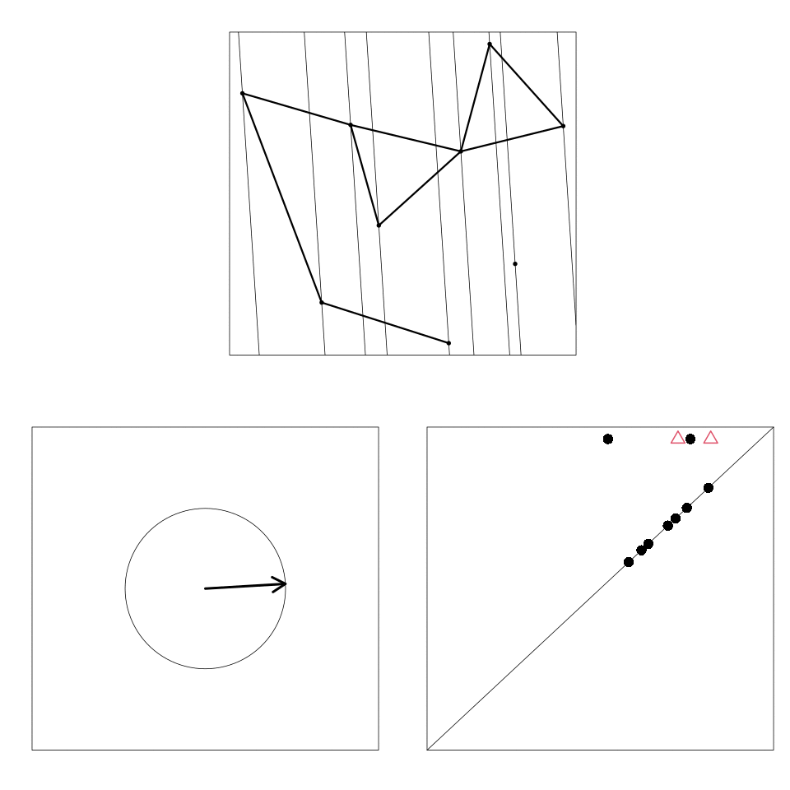
$$(K, {\text{𝕊} }^{1})$$
How much can a set $\left(K,S\right)$ tell us about $K$?

Slide 21
Faithful Sets
$\left(K,S\right)$ is faithful if it uniquely determines $K$

Slide 22
Faithful Sets
$\left(K,S\right)$ is faithful if it uniquely determines $K$
$(K, \left\{s_{1}\right\})$ is not faithful
But $(K, \left\{s_{1},s_{2}\right\})$ is faithful!
There is no faithful set with smaller cardinality;
We have found a minimum faithful set.
$$s_{1}$$
$$s_{2}$$

Slide 23
Related Work
$(K, {\text{𝕊}}^{d−1})$ using concise diagrams is faithful for $d=2,3$ [Turner et al., 2014]
An explicit and finite faithful set $\left(K,S\right)$ for $K$immersed in 2D [Belton, S., et al., 2018]
Fasy et al. extend these results to arbitrary finite dimension [Fasy, S., et al., 2019]
Curry et al. bound the size of a faithful set of concise persistence diagrams, assuming bounded curvature [Curry et al., 2018]

Slide 24
Related Work
[Turner et al., 2014]
Can we find small faithful sets?
Or at least understand them better?

Slide 25
Minimal Faithful Sets
In many examples, we find minimal faithful sets with size $d+1$
Independent of the number of simplices
Not too surprising -- a single verbose diagram has a point for every simplex height
Does cardinality of a minimal faithful set ever depend on the number of simplices?
YES! Keep watching

Slide 26
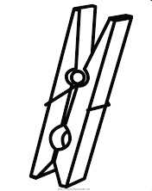
Clothespin Construction
$$v_{4}$$
$$v_{4}$$
$$v_{3}$$
$$v_{3}$$
$$v_{1}$$
$$v_{2}$$
$$v_{1}$$
$$v_{2}$$
$$K$$
$$K′$$

Slide 27
Clothespin Construction
$$v_{4}$$
$$v_{4}$$
$$v_{3}$$
$$v_{3}$$
$$v_{1}$$
$$v_{2}$$
$$v_{1}$$
$$v_{2}$$
$$K$$
$$K′$$

Slide 28
Clothespin Construction
$$v_{4}$$
$$v_{4}$$
$$v_{3}$$
$$v_{3}$$
$$v_{1}$$
$$v_{2}$$
$$v_{1}$$
$$v_{2}$$
$$K$$
$$K′$$

Slide 29
Clothespin Construction
$$v_{4}$$
$$v_{4}$$
$$v_{3}$$
$$v_{3}$$
$$v_{1}$$
$$v_{2}$$
$$v_{1}$$
$$v_{2}$$
$$K$$
$$K′$$
This direction cannot distinguish $K$ from $K$’

Slide 30
Clothespin Construction
$$v_{4}$$
$$v_{4}$$
$$v_{3}$$
$$v_{3}$$
$$v_{1}$$
$$v_{2}$$
$$v_{1}$$
$$v_{2}$$
$$K$$
$$K′$$

Slide 31
Clothespin Construction
$$v_{4}$$
$$v_{4}$$
$$v_{3}$$
$$v_{3}$$
$$v_{1}$$
$$v_{2}$$
$$v_{1}$$
$$v_{2}$$
$$K$$
$$K′$$
This direction can distinguish $K$ from $K$’
Can we characterize directions with this ability?

Slide 32
Clothespin Construction
$$v_{4}$$
$$v_{3}$$
$$v_{1}$$
$$v_{2}$$
Gray directions can distinguish $K$ from $K$’
We can make the region arbitrarily small

Slide 33
Clothespin Construction
$$v_{4}$$
$$v_{3}$$
$$v_{1}$$
$$v_{2}$$
These directions can distinguish $K$ from $K$’
We can make the region arbitrarily small

Slide 34
Arrange $m$ clothespins so the gray regions do not overlap
At least one direction from each gray region -> cardinality $\text{Ω}(n)$
Minimum faithful set depends on the size of the complex

Slide 35
Ongoing Work
Find higher-dimensional examples where minimum faithful set depends on number of simplices
Characterize simplicial complexes whose minimum faithful sets have cardinality $d+1$
Examples where minimum sets of verbose persistence diagrams have different cardinality than minimal sets of other descriptors

