Slide 1
Robust Bichromatic Classification using Two Lines
Erwin Glazenburg, Thijs van der Horst, Tom Peters, Bettina Speckmann, Frank Staals

Slide 2
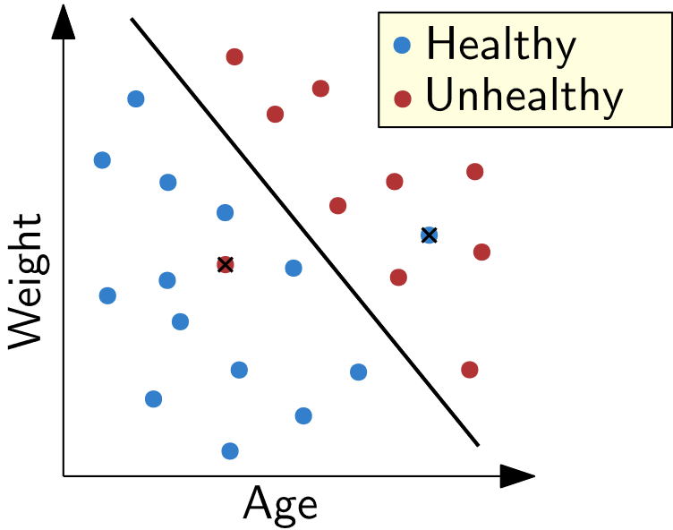
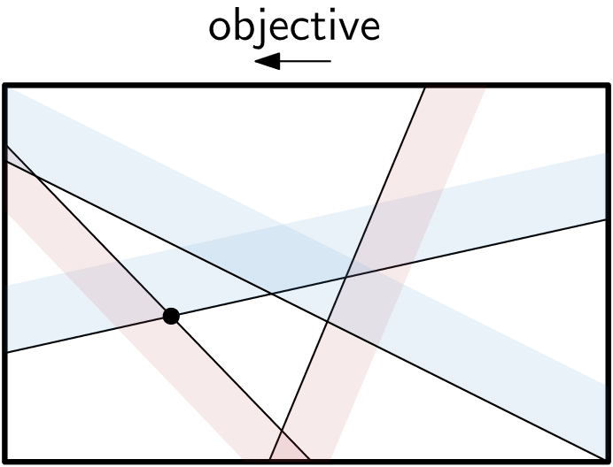
Separating points with lines
Robust Bichromatic Classification using Two Lines
Classification
Linear Programming

Slide 3
Separate R and B, outliers
Robust Bichromatic Classification using Two Lines
Perfect: O(n)
Minimize red/blue outliers: O(n log n)
Minimize both outliers: O((n + k^2) log n) (Chan 2005)

Slide 4
Separate R and B, many violations?
Robust Bichromatic Classification using Two Lines

Slide 5
Separate R and B, many violations?
Robust Bichromatic Classification using Two Lines

Slide 6
Separate R and B, two lines
All cases: O(n log n) (Hurtado et al, 2001, 2004)

Slide 7
Separate R and B, two lines with outliers
Notes:
\begin{table}[tb] \caption{An overview of our results.} \centering \begin{tabular}{l llllll} \toprule region $W_B$ & \multicolumn{2}{c}{minimize $k_R$} & \multicolumn{2}{c}{minimize $k_B$} & \multicolumn{2}{c}{minimize $k$} \\ \midrule halfplane & $O(n\log n)$ & & $O(n\log n)$ & & $O((n+k^2)\log n)$&\\ strip & $\Theta(n\log n)$& & $O(n^2\log n)$ & & $O(n^2\log n)$ &\\ wedge & $O(n^2)$ & &$O(n^2k_B$ & & $O((n^2k + nk^3)$ & \\ & $\Theta(n\log n)$ & & \multicolumn{1}{r}{\hspace{0.03\textwidth}\quad$\log n \log k_B)$} & & \multicolumn{1}{r}{$\log n \log k)$} &\\ double bowtie \\ \multicolumn{1}{r}{wedge} & $O(n^2)$ & & $O(n^2 \log n)$ & & $O(n^4)$ & \\ \bottomrule \end{tabular} \label{tab:overview_results}\end{table}

Slide 8
Separate R and B, two lines with outliers

Slide 9
Separate R and B, two lines with outliers

Slide 10
Separate R and B: wedge, red outliers

Slide 11
Separate R and B: wedge, red outliers

Slide 12
Separate R and B: wedge, red outliers

Slide 13
Separate R and B: wedge, red outliers

Slide 14
Separate R and B: wedge, red outliers

Slide 15
Separate R and B: wedge, red outliers

Slide 16
Separate R and B: wedge, red outliers

Slide 17
Separate R and B: wedge, red outliers

Slide 18
Separate R and B: wedge, red outliers

Slide 19
Separate R and B: wedge, red outliers

Slide 20
Separate R and B: wedge, red outliers

Slide 21
Separate R and B: wedge, red outliers

Slide 22
Separate R and B: wedge, red outliers

Slide 23
Separate R and B: wedge, red outliers
LE
UE

Slide 24
Separate R and B: wedge, red outliers
LE
UE

Slide 25
Separate R and B: wedge, red outliers
LE
UE

Slide 26
Separate R and B: wedge, red outliers
LE
UE

Slide 27
Separate R and B: wedge, red outliers
LE
UE

Slide 28
Separate R and B: wedge, red outliers
LE
UE

Slide 29
Separate R and B: wedge, red outliers
LE
UE

Slide 30
Separate R and B: wedge, red outliers
LE
UE

Slide 31
Separate R and B: wedge, red outliers
LE
UE

Slide 32
Separate R and B: wedge, red outliers
LE
UE

Slide 33
Separate R and B: wedge, red outliers
LE
UE

Slide 34
Separate R and B: wedge, red outliers
LE
UE

Slide 35
Separate R and B: wedge, red outliers
3
2
1
LE
2
UE

Slide 36
Separate R and B: wedge, red outliers
LE
O(n log n)
UE

Slide 37
Separate R and B, two lines with violations

Slide 38
Separate R and B, two lines with violations
Thanks for listening :)

Slide 39
Vragen?

Slide 40
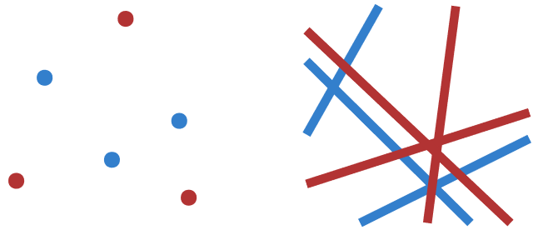
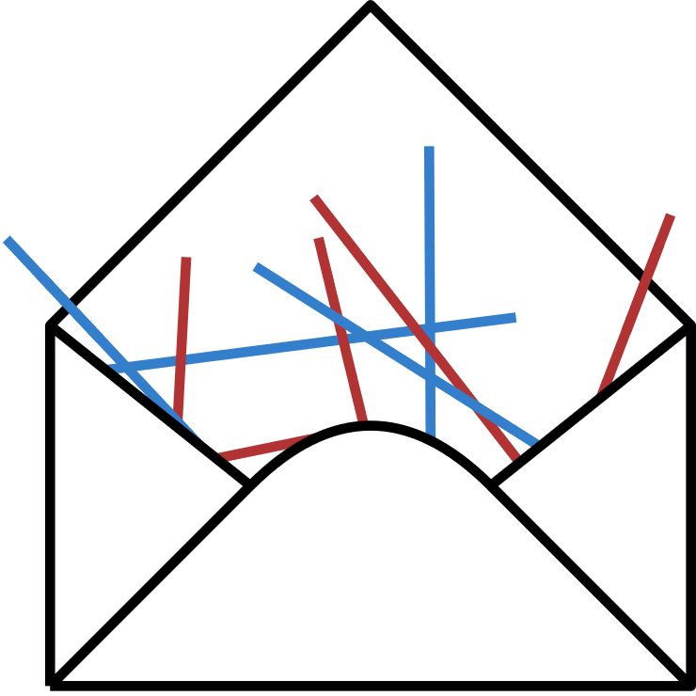
S3A: Robust Bichromatic Classification using Two Lines
If you like:
2023 2024
1 line → 2 lines!!
Envelopes
Duality
Wedges and strips
This thing:
Erwin Glazenburg, Thijs van der Horst, Tom Peters, Bettina Speckmann, Frank Staals

